Slide 1
Using Deep Learning on Satellite Images to Identify Deforestation/Afforestation
(PaperID ICCVBIC- 081)
ICCVBIC 2019
Presentation on
By Apurva M., Navin Kumar M., Mahadevan N., Aaditya G., Ajun N., Akash N.
Dept. of Computer Engineering, SIES Graduate School of Technology, Navi Mumbai, India

Slide 2
Contents
Introduction
Objectives
Background
Dataset
Mask RCNN
Architecture of the Proposed System
Implementation
Results
Applications
Conclusion

Slide 3
Introduction
In India, forest cover was 21% by the end of the last decade.
Lack of human resources in the Ministry of Environment, Forest and Climate change.
Much of the Himalayan ranges are geographically challenging to monitor.
Changes usually come to notice after a substantial portion of forest has been lost.

Slide 4
Objectives
Propose a system for this problem.
Lay the groundwork.
Deliver an end-to-end trainable model.

Slide 5
Background
Determine relationship between deforestation and socioeconomic factors using ANN and GIS.
Competition to classify various images of Amazon forest.
Establish forest structural features, stem density and basal area using ANN.
Analyse historical data of forests and determine future forest loss
Identify factors of direct deforestation drivers using Bayesian Multivariate Classifier.

Slide 6
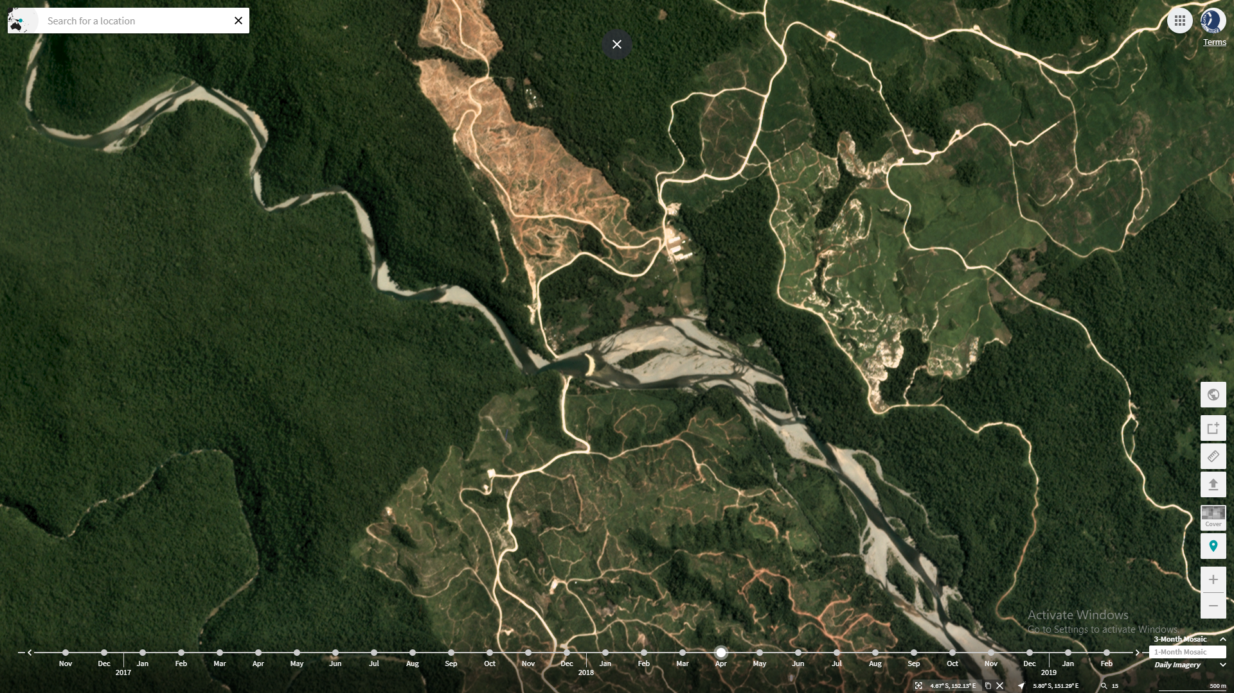
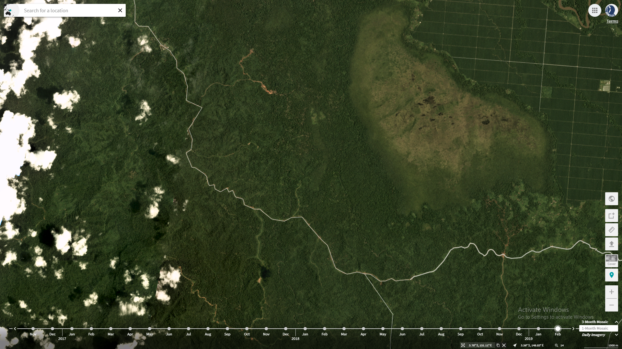
Dataset

Slide 7
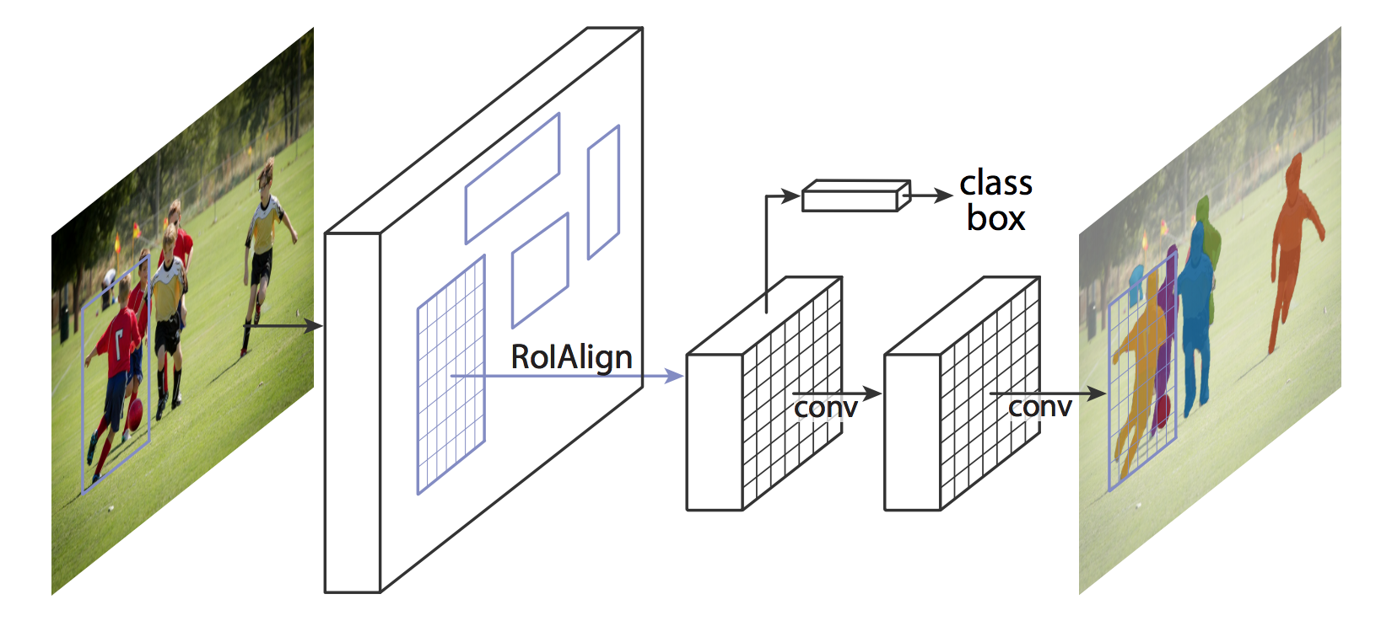
Mask RCNN

Slide 8
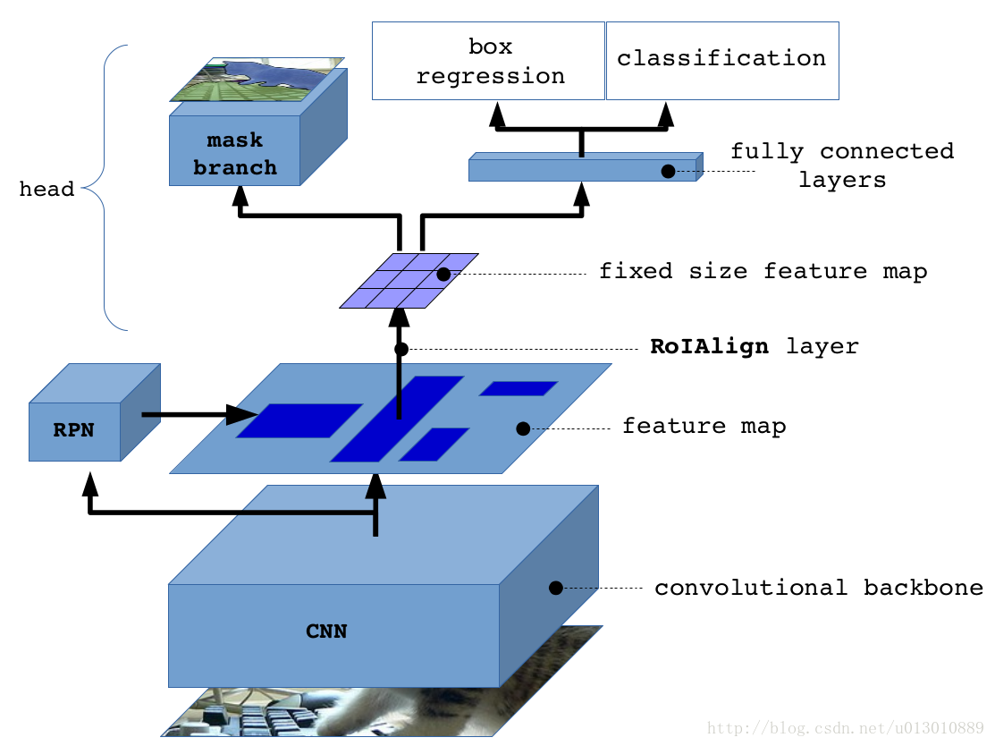

Slide 9
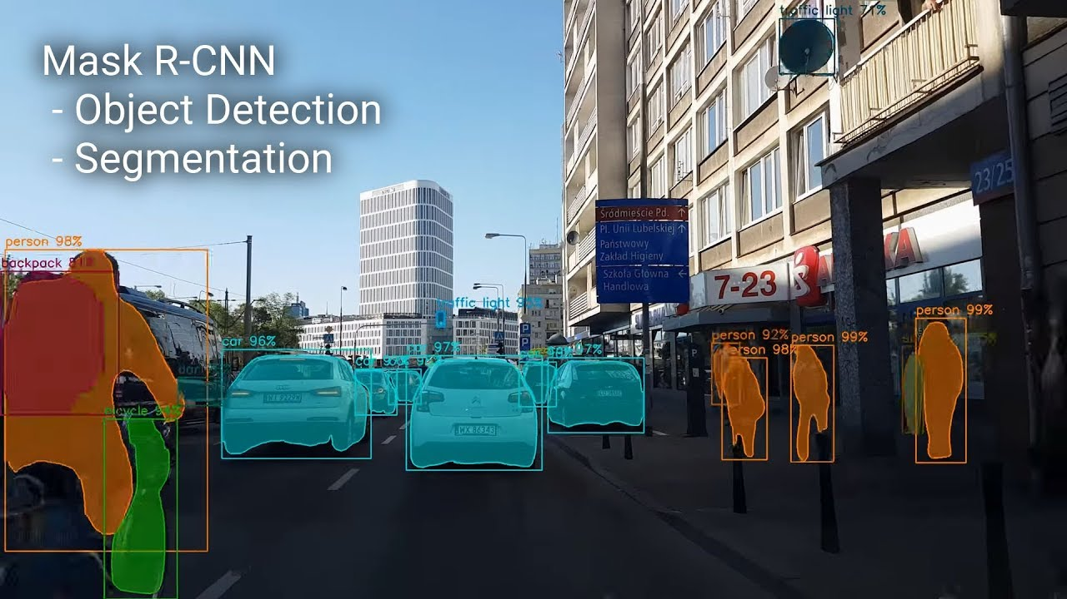

Slide 10
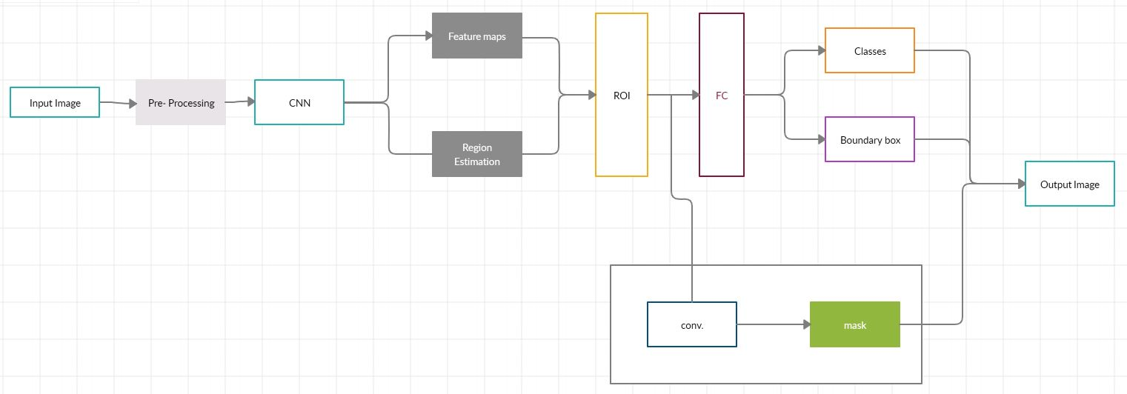
Architecture of Proposed System

Slide 11
Implementation
Training
Over 12 hours and for around 10000 iterations.
Error rate above 62% at early stages.
Testing
Validation dataset of 120 images.
Few images with only 1 class label detected i.e. forest cover.
Many images with accuracy over 90% detecting both forest and barren land.

Slide 12
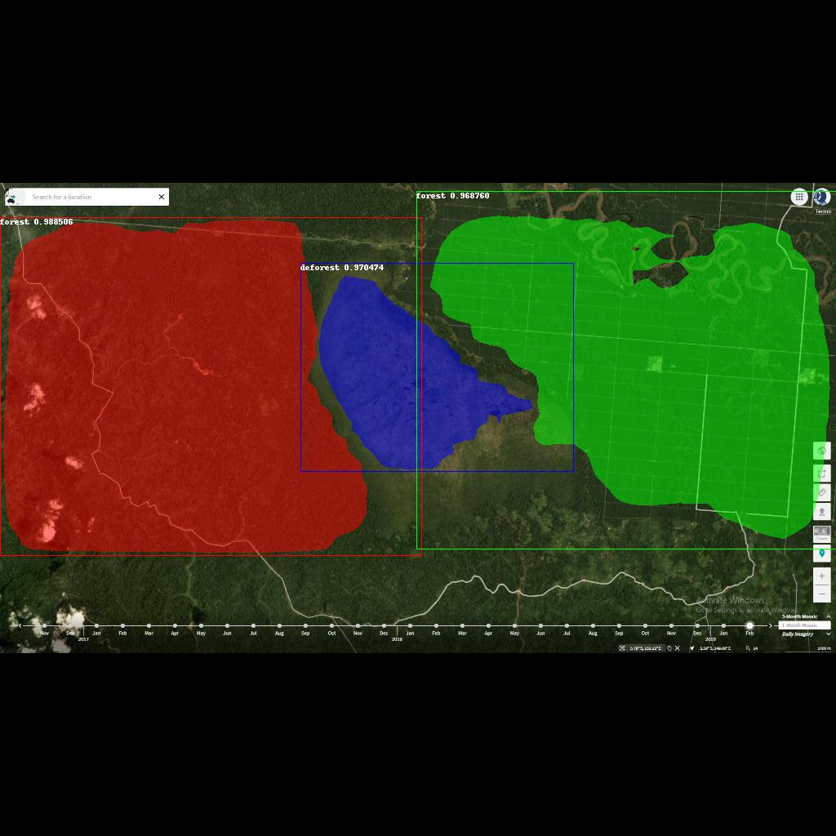
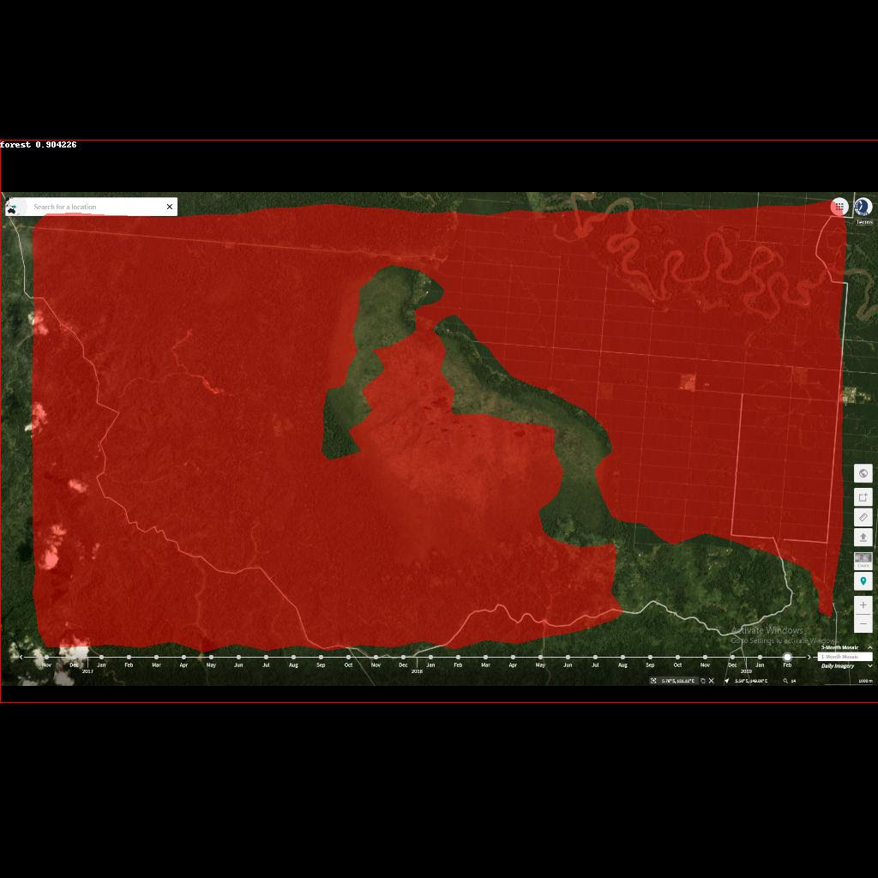
Results

Slide 13

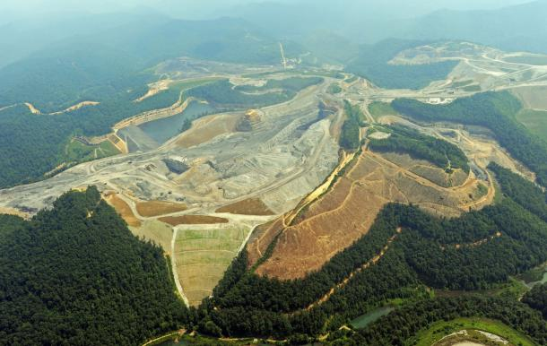
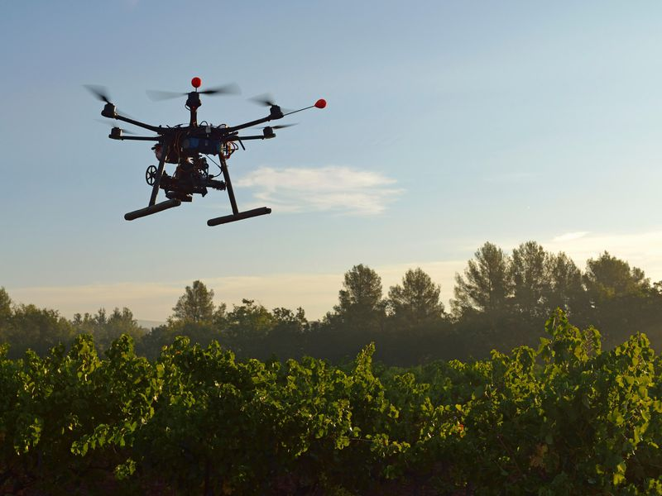
Applications

Slide 14
Conclusion
Proof of concept.
Improvement and efficiency.
More class labels.
Better and varied dataset.
Real time analysis of forest cover.
Assess and Access geographically challenging locations.
Preventing/Reducing rate of deforestation.
Tracks Afforestation.

Slide 15
THANK YOU

